Slide 1
Social Network Analysis: BFS and DFS for Exploring Connectivity

Slide 2
OBJECTIVES:
Data Loading and Graph Construction:
It loads relationship data from an XML file using the ElementTree module.
Constructs a graph where each person is a node, and relationships are edges between them.
Nodes are labeled with genders and colors are assigned based on gender.
Graph Visualization:
Positions nodes in the graph using the Fruchterman-Reingold force-directed algorithm.
Visualizes the graph using Matplotlib, with nodes labeled and colored based on gender.
Traversals:
Implements Breadth-First Search (BFS) and Depth-First Search (DFS) traversal algorithms.
Executes BFS and DFS traversals starting from a specified node ("vijay" in this case).
Visualizes the traversal process by highlighting visited nodes.

Slide 3
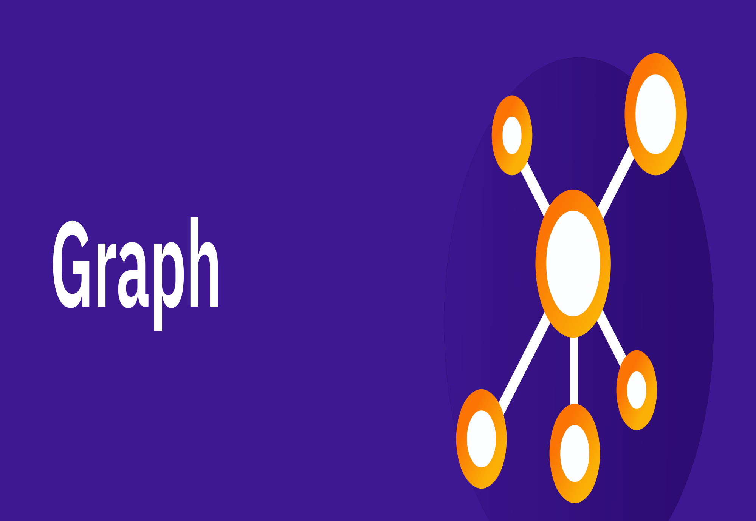

Slide 4
GRAPH INTRODUCTION
A Graph is a non-linear data structure consisting of vertices and edges. The vertices are sometimes also referred to as nodes and the edges are lines or arcs that connect any two nodes in the graph. More formally a Graph is composed of a set of vertices( V ) and a set of edges( E ). The graph is denoted by G(V, E).
Graph data structures are a powerful tool for representing and analyzing complex relationships between objects or entities. They are particularly useful in fields such as social network analysis, recommendation systems, and computer networks

Slide 5
In the field of sports data science, graph data structures can be used to analyze and understand the dynamics of team performance and player interactions on the field.
Imagine a game of football as a web of connections, where players are the nodes and their interactions on the field are the edges. This web of connections is exactly what a graph data structure represents, and it’s the key to unlocking insights into team performance and player dynamics in sports.

Slide 6
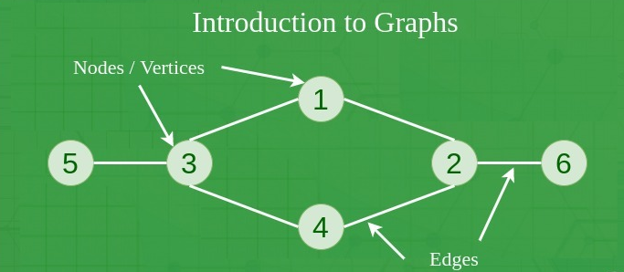

Slide 7
COMPONENTS OF A GRAPH
Vertices: Vertices are the fundamental units of the graph. Sometimes, vertices are also known as vertex or nodes. Every node/vertex can be labeled or unlabelled.
Edges: Edges are drawn or used to connect two nodes of the graph. It can be ordered pair of nodes in a directed graph. Edges can connect any two nodes in any possible way. There are no rules. Sometimes, edges are also known as arcs. Every edge can be labelled/unlabelled.

Slide 8
Weight: A weight can be assigned to an edge, representing the cost or distance between two vertices. A weighted graph is a graph where the edges have weights.
Degree: The degree of a vertex is the number of edges that connect to it. In a directed graph, the in-degree of a vertex is the number of edges that point to it, and the out-degree is the number of edges that start from it.
Path: A path is a sequence of vertices that are connected by edges. A simple path does not contain any repeated vertices or edges.
Cycle: A cycle is a path that starts and ends at the same vertex. A simple cycle does not contain any repeated vertices or edges.
Connectedness: A graph is said to be connected if there is a path between any two vertices. A disconnected graph is a graph that is not connected.

Slide 9
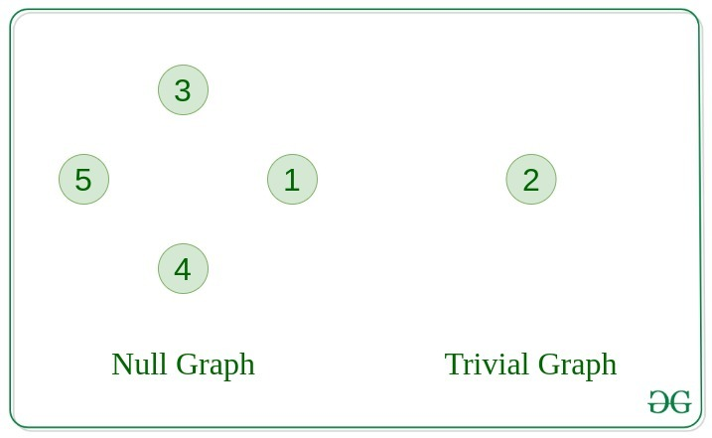
TYPES OF GRAPH
Null Graph
A graph is known as a null graph if there are no edges in the graph.
Trivial Graph
Graph having only a single vertex, it is also the smallest graph possible

Slide 10
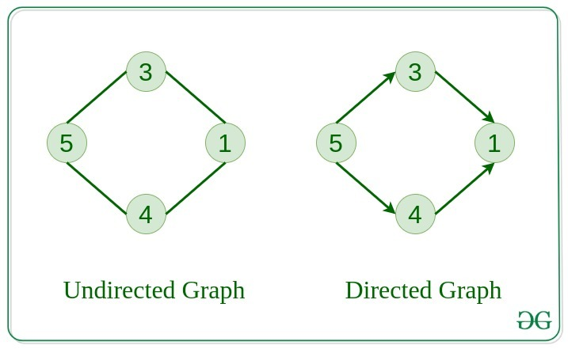
Undirected Graph
A graph in which edges do not have any direction. That is the nodes are unordered pairs in the definition of every edge.
Directed Graph
A graph in which edge has direction. That is the nodes are ordered pairs in the definition of every edge.

Slide 11
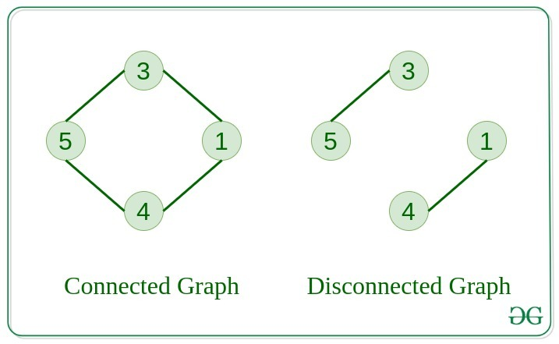
Connected Graph
The graph in which from one node we can visit any other node in the graph is known as a connected graph.
Disconnected Graph
The graph in which at least one node is not reachable from a node is known as a disconnected graph.

Slide 12
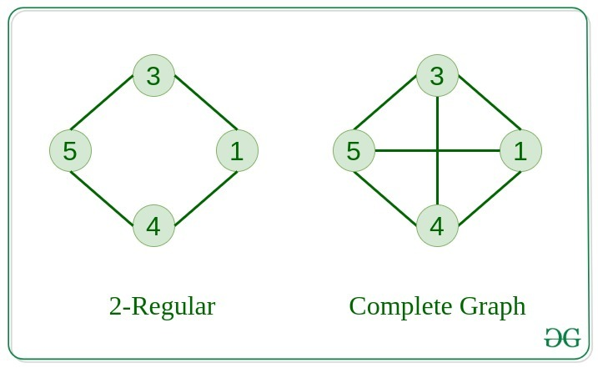
Regular Graph
The graph in which the degree of every vertex is equal to K is called K regular graph.
Complete Graph
The graph in which from each node there is an edge to each other node.

Slide 13
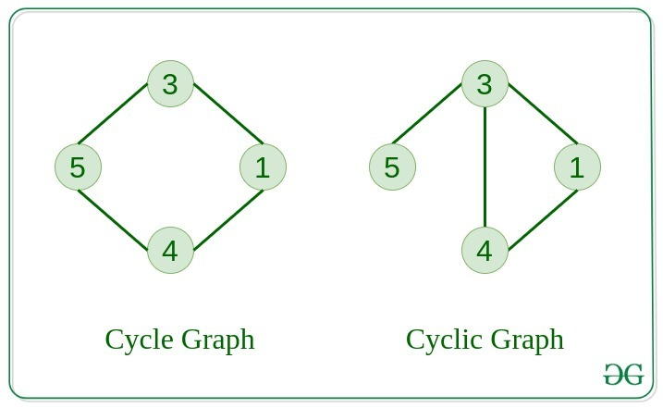
Cycle Graph
The graph in which the graph is a cycle in itself, the degree of each vertex is 2.
Cyclic Graph
A graph containing at least one cycle is known as a Cyclic graph.

Slide 14
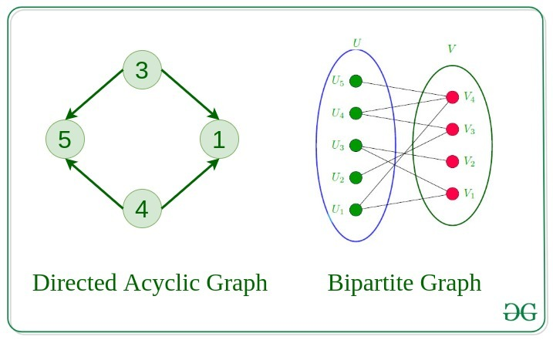
Directed Acyclic Graph
A Directed Graph that does not contain any cycle.
Bipartite Graph
A graph in which vertex can be divided into two sets such that vertex in each set does not contain any edge between them.

Slide 15
Weighted Graph
A graph in which the edges are already specified with suitable weight is known as a weighted graph.
Weighted graphs can be further classified as directed weighted graphs and undirected weighted graphs.

Slide 16
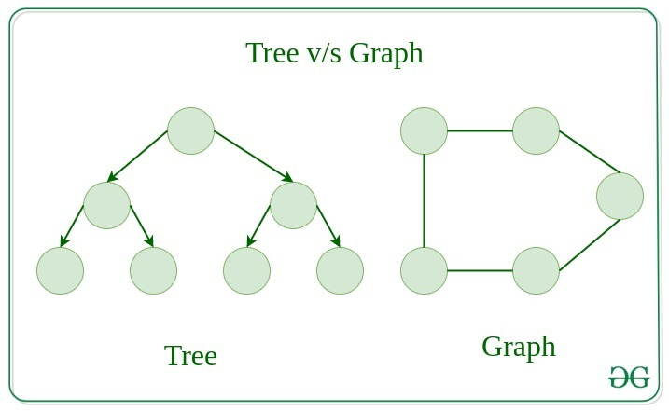
Tree v/s Graph
Trees are the restricted types of graphs, just with some more rules. Every tree will always be a graph but not all graphs will be trees. Linked List, Trees, and Heaps all are special cases of graphs.

Slide 17
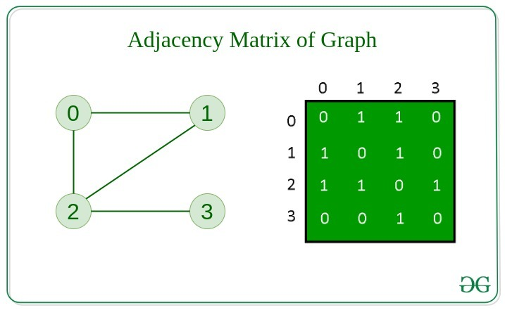
REPRESENTATION OF GRAPHS
There are two ways to store a graph:
Adjacency Matrix
Adjacency List
Adjacency Matrix
In this method, the graph is stored in the form of the 2D matrix where rows and columns denote vertices. Each entry in the matrix represents the weight of the edge between those vertices.

Slide 18
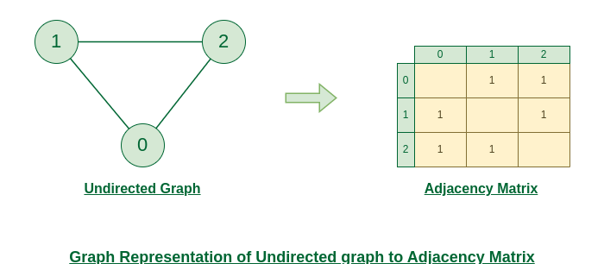

Slide 19
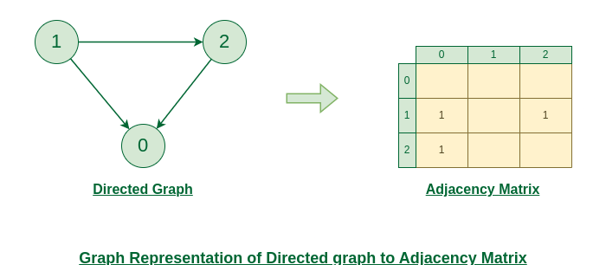

Slide 20
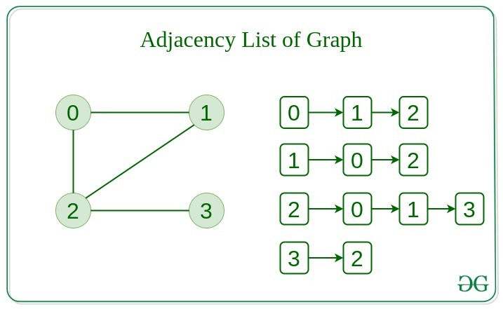
Adjacency List
This graph is represented as a collection of linked lists. There is an array of pointer which points to the edges connected to that vertex.

Slide 21
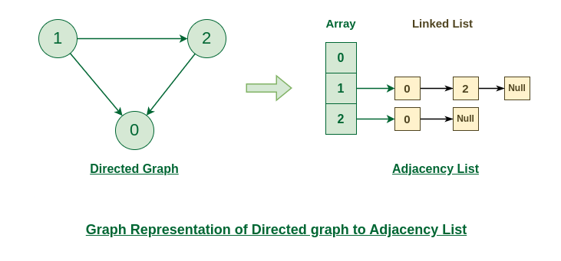

Slide 22
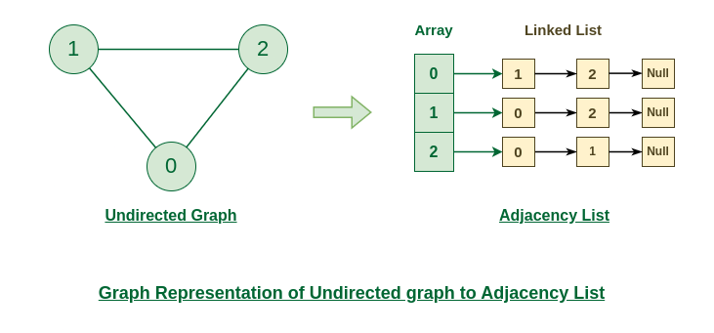

Slide 23
Basic Operations on Graphs
Below are the basic operations on the graph:
Insertion of Nodes/Edges in the graph – Insert a node into the graph.
Deletion of Nodes/Edges in the graph – Delete a node from the graph.
Searching on Graphs – Search an entity in the graph.
Traversal of Graphs – Traversing all the nodes in the graph.
Usage of graphs
Maps can be represented using graphs and then can be used by computers to provide various services like the shortest path between two cities.
When various tasks depend on each other then this situation can be represented using a Directed Acyclic graph and we can find the order in which tasks can be performed using topological sort.
State Transition Diagram represents what can be the legal moves from current states. In-game of tic tac toe this can be used.

Slide 24
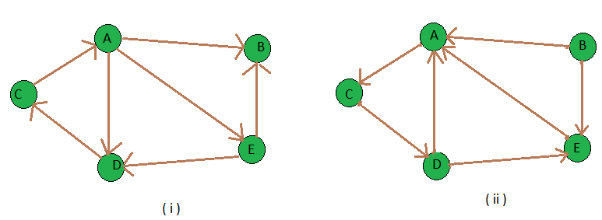
Transpose graph
Transpose of a directed graph G is another directed graph on the same set of vertices with all of the edges reversed compared to the orientation of the corresponding edges in G. That is, if G contains an edge (u, v) then the converse/transpose/reverse of G contains an edge (v, u) and vice versa. Given a graph (represented as adjacency list), we need to find another graph which is the transpose of the given graph.

Slide 25
Real-Time Applications of Graph:
Social media analysis: Social media platforms generate vast amounts of data in real-time, which can be analyzed using graphs to identify trends, sentiment, and key influencers. This can be useful for marketing, customer service, and reputation management.
Network monitoring: Graphs can be used to monitor network traffic in real-time, allowing network administrators to identify potential bottlenecks, security threats, and other issues. This is critical for ensuring the smooth operation of complex networks.
Financial trading: Graphs can be used to analyze real-time financial data, such as stock prices and market trends, to identify patterns and make trading decisions. This is particularly important for high-frequency trading, where even small delays can have a significant impact on profits.
Internet of Things (IoT) management: IoT devices generate vast amounts of data in real-time, which can be analyzed using graphs to identify patterns, optimize performance, and detect anomalies. This is important for managing large-scale IoT deployments.
Autonomous vehicles: Graphs can be used to model the real-time environment around autonomous vehicles, allowing them to navigate safely and efficiently. This requires real-time data from sensors and other sources, which can be processed using graph algorithms.
Disease surveillance: Graphs can be used to model the spread of infectious diseases in real-time, allowing health officials to identify outbreaks and implement effective containment strategies. This is particularly important during pandemics or other public health emergencies.
The best example of graphs in the real world is Facebook. Each person on Facebook is a node and is connected through edges. Thus, A is a friend of B. B is a friend of C, and so on.

Slide 26
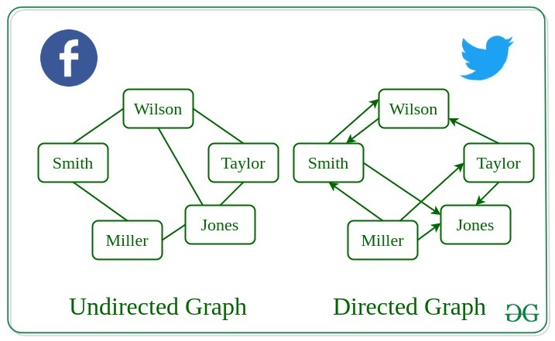
Real-Life Applications of Graph

Slide 27
Advantages:
Graphs are a versatile data structure that can be used to represent a wide range of relationships and data structures.
They can be used to model and solve a wide range of problems, including pathfinding, data clustering, network analysis, and machine learning.
Graph algorithms are often very efficient and can be used to solve complex problems quickly and effectively.
Graphs can be used to represent complex data structures in a simple and intuitive way, making them easier to understand and analyze.
Disadvantages:
Graphs can be complex and difficult to understand, especially for people who are not familiar with graph theory or related algorithms.
Creating and manipulating graphs can be computationally expensive, especially for very large or complex graphs.
Graph algorithms can be difficult to design and implement correctly, and can be prone to bugs and errors.
Graphs can be difficult to visualize and analyze, especially for very large or complex graphs, which can make it challenging to extract meaningful insights from the data.

Slide 28
BFS AND DFS IN GRAPH

Slide 29
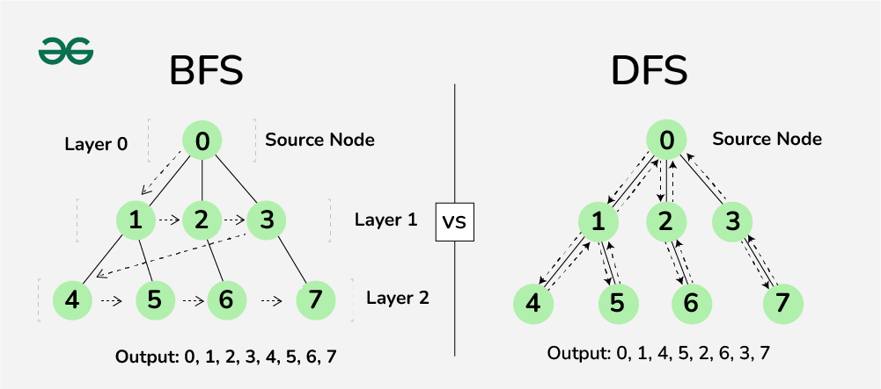
Difference between BFS and DFS

Slide 30
Depth First Search or DFS for a Graph
Depth First Traversal (or DFS) for a graph is similar to Depth First Traversal of a tree. The only catch here is, that, unlike trees, graphs may contain cycles (a node may be visited twice). To avoid processing a node more than once, use a boolean visited array. A graph can have more than one DFS traversal.
Input: n = 4, e = 6
0 -> 1, 0 -> 2, 1 -> 2, 2 -> 0, 2 -> 3, 3 -> 3
Output:
DFS from vertex 1 : 1 2 0 3
DFS Diagram:

Slide 31
Iterative Depth First Traversal of Graph
Input: n = 4, e = 6
2 -> 0, 0 -> 2, 1 -> 2, 0 -> 1, 3 -> 3, 1 -> 3
Output:
DFS from vertex 2 : 2 0 1 3
Algorithm:
Created a stack of nodes and visited array.
Insert the root in the stack.
Run a loop till the stack is not empty.
Pop the element from the stack and print the element.
For every adjacent and unvisited node of current node,mark the node and insert it in the stack.
Implementation of Iterative DFS:
This is similar to BFS, the only difference is queue is replaced by stack.
DFS Diagram:

Slide 32
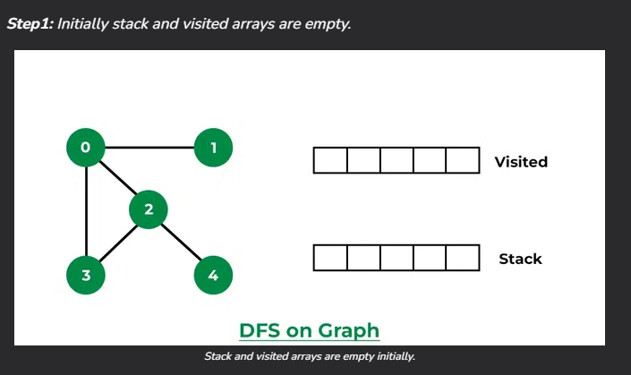
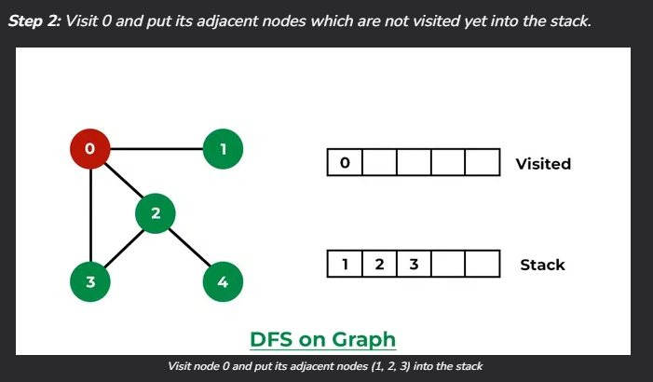
How does DFS work?
Depth-first search is an algorithm for traversing or searching tree or graph data structures. The algorithm starts at the root node (selecting some arbitrary node as the root node in the case of a graph) and explores as far as possible along each branch before backtracking.
Let us understand the working of Depth First Search with the help of the following illustration:

Slide 33
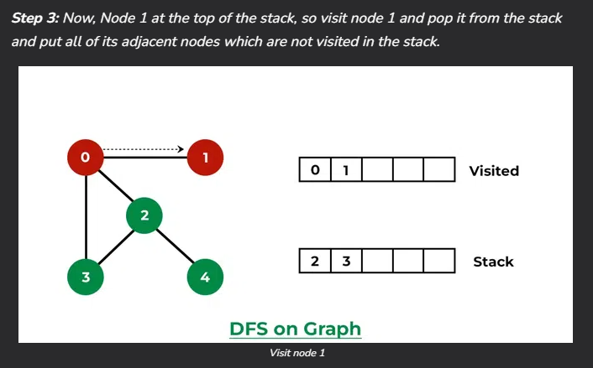
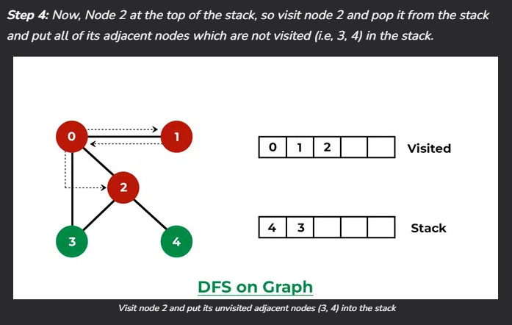
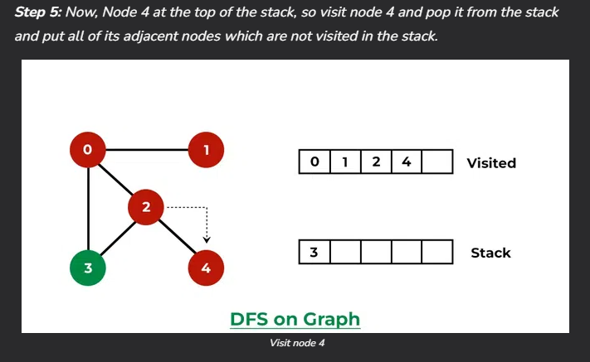
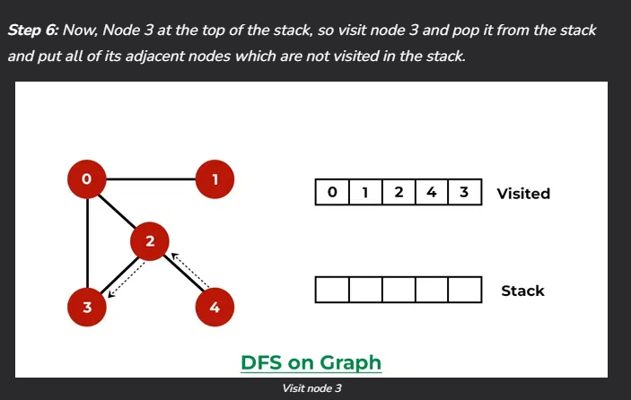

Slide 34
Applications of Depth First Search:
Detecting cycle in a graph: A graph has a cycle if and only if we see a back edge during DFS. So we can run DFS for the graph and check for back edges.
Path Finding: We can specialize the DFS algorithm to find a path between two given vertices u and z.
Call DFS(G, u) with u as the start vertex.
Use a stack S to keep track of the path between the start vertex and the current vertex.
As soon as destination vertex z is encountered, return the path as the contents of the stack
Topological Sorting: Topological Sorting is mainly used for scheduling jobs from the given dependencies among jobs. In computer science, applications of this type arise in instruction scheduling, ordering of formula cell evaluation when recomputing formula values in spreadsheets, logic synthesis, determining the order of compilation tasks to perform in makefiles, data serialization, and resolving symbol dependencies in linkers.
To test if a graph is bipartite: We can augment either BFS or DFS when we first discover a new vertex, color it opposite its parents, and for each other edge, check it doesn’t link two vertices of the same color. The first vertex in any connected component can be red or black.

Slide 35
Finding Strongly Connected Components of a graph: A directed graph is called strongly connected if there is a path from each vertex in the graph to every other vertex. (See this for DFS-based algo for finding Strongly Connected Components)
Solving puzzles with only one solution: such as mazes. (DFS can be adapted to find all solutions to a maze by only including nodes on the current path in the visited set.).
Web crawlers: Depth-first search can be used in the implementation of web crawlers to explore the links on a website.
Maze generation: Depth-first search can be used to generate random mazes.
Model checking: Depth-first search can be used in model checking, which is the process of checking that a model of a system meets a certain set of properties.
Backtracking: Depth-first search can be used in backtracking algorithms.

Slide 36
Breadth First Search or BFS for a Graph
The Breadth First Search (BFS) algorithm is used to search a graph data structure for a node that meets a set of criteria. It starts at the root of the graph and visits all nodes at the current depth level before moving on to the nodes at the next depth level.
Relation between BFS for Graph and Tree traversal:
Breadth-First Traversal (or Search) for a graph is similar to the Breadth-First Traversal of a tree.
The only catch here is, that, unlike trees, graphs may contain cycles, so we may come to the same node again. To avoid processing a node more than once, we divide the vertices into two categories:
Visited and
Not visited.
A boolean visited array is used to mark the visited vertices. For simplicity, it is assumed that all vertices are reachable from the starting vertex. BFS uses a queue data structure for traversal.

Slide 37
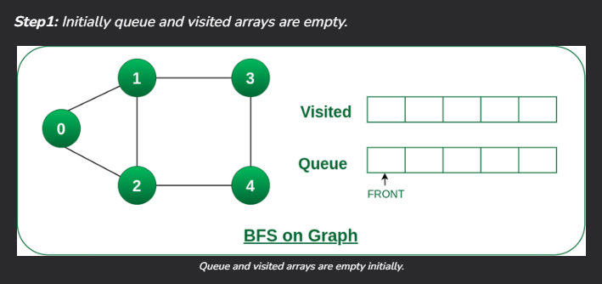
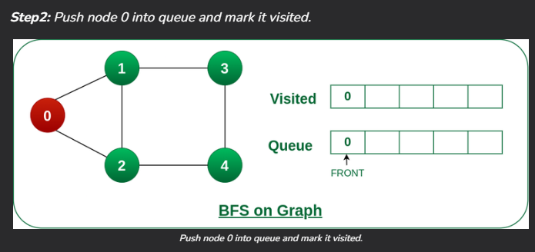
How does DFS work?
Starting from the root, all the nodes at a particular level are visited first and then the nodes of the next level are traversed till all the nodes are visited.
To do this a queue is used. All the adjacent unvisited nodes of the current level are pushed into the queue and the nodes of the current level are marked visited and popped from the queue.
Illustration:
Let us understand the working of the algorithm with the help of the following example

Slide 38
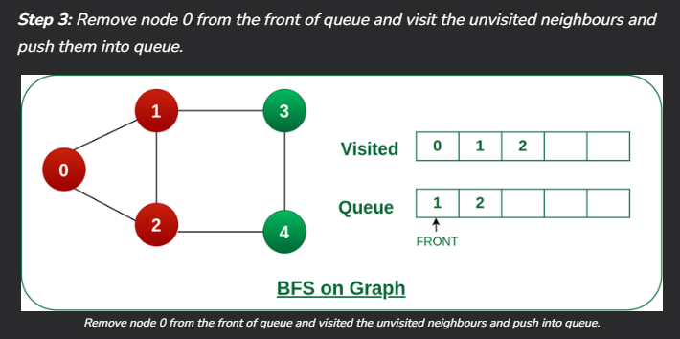
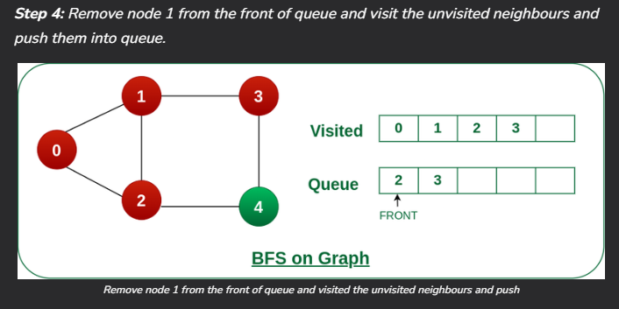
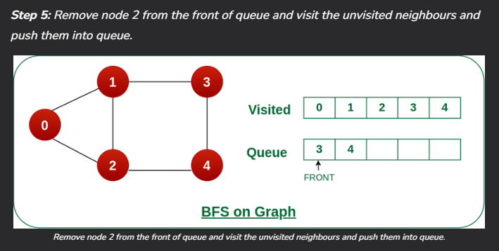
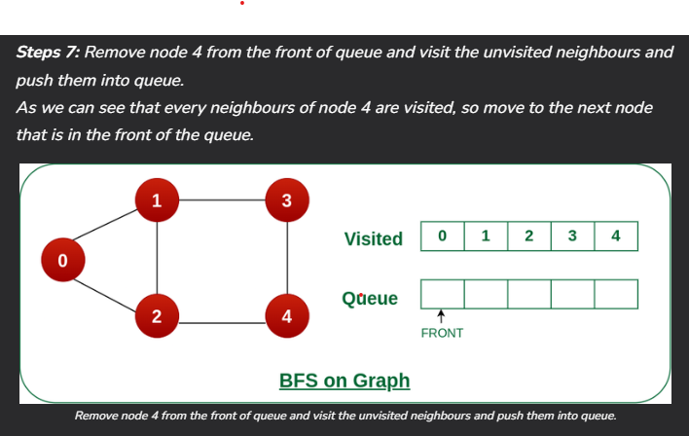
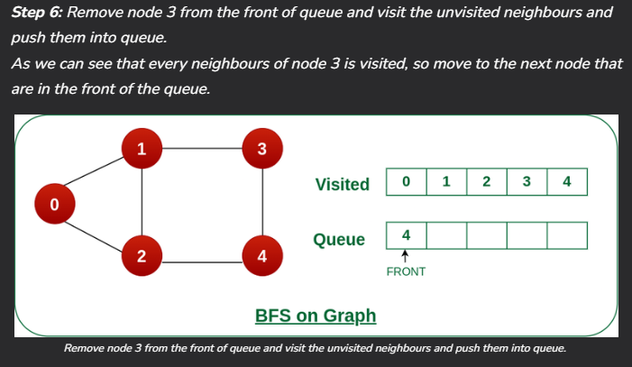

Slide 39
Applications of Breadth First Search:
Shortest Path and Minimum Spanning Tree for unweighted graph: In an unweighted graph, the shortest path is the path with the least number of edges. With Breadth First, we always reach a vertex from a given source using the minimum number of edges. Also, in the case of unweighted graphs, any spanning tree is Minimum Spanning Tree and we can use either Depth or Breadth first traversal for finding a spanning tree.
Minimum Spanning Tree for weighted graphs: We can also find Minimum Spanning Tree for weighted graphs using BFT, but the condition is that the weight should be non-negative and the same for each pair of vertices.
Peer-to-Peer Networks: In Peer-to-Peer Networks like BitTorrent, Breadth First Search is used to find all neighbor nodes.
Crawlers in Search Engines: Crawlers build an index using Breadth First. The idea is to start from the source page and follow all links from the source and keep doing the same. Depth First Traversal can also be used for crawlers, but the advantage of Breadth First Traversal is, the depth or levels of the built tree can be limited.
Social Networking Websites: In social networks, we can find people within a given distance ‘k’ from a person using Breadth First Search till ‘k’ levels.

Slide 40
GPS Navigation systems: Breadth First Search is used to find all neighboring locations.
Broadcasting in Network: In networks, a broadcasted packet follows Breadth First Search to reach all nodes.
In Garbage Collection: Breadth First Search is used in copying garbage collection using Cheney’s algorithm. Breadth First Search is preferred over Depth First Search because of a better locality of reference.
Cycle detection in undirected graph: In undirected graphs, either Breadth First Search or Depth First Search can be used to detect a cycle. We can use BFS to detect cycle in a directed graph also.
Ford–Fulkerson algorithm In Ford – Fulkerson algorithm, we can either use Breadth First or Depth First Traversal to find the maximum flow. Breadth First Traversal is preferred as it reduces the worst-case time complexity to O(VE2).
To test if a graph is Bipartite: We can either use Breadth First or Depth First Traversal.
Path Finding: We can either use Breadth First or Depth First Traversal to find if there is a path between two vertices.
Finding all nodes within one connected component: We can either use Breadth First or Depth First Traversal to find all nodes reachable from a given node.

Slide 41
AI: In AI, BFS is used in traversing a game tree to find the best move.
Network Security: In the field of network security, BFS is used in traversing a network to find all the devices connected to it.
Connected Component: We can find all connected components in an undirected graph.
Topological sorting: BFS can be used to find a topological ordering of the nodes in a directed acyclic graph (DAG).
Image processing: BFS can be used to flood-fill an image with a particular color or to find connected components of pixels.
Recommender systems: BFS can be used to find similar items in a large dataset by traversing the items’ connections in a similarity graph.
Other usages: Many algorithms like Prim’s Minimum Spanning Tree and Dijkstra’s Single Source Shortest Path use structures similar to Breadth First Search.

Slide 42
Difference between BFS and DFS

Slide 43
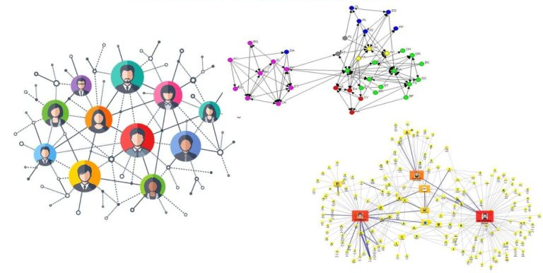
Network Analysis
Social Network Analysis

Slide 44
What is Network?
A network is a collection of interconnected entities or nodes that can communicate or exchange information with one another. Networks can be found in many different contexts, including social, technological, and biological systems.
In a social network, the nodes might be individuals, and the connections between them might represent relationships such as friendship, family ties, or professional collaboration.
In a technological network, the nodes might be devices such as computers or smartphones, and the connections between them might represent internet or cellular connections. In a biological network, the nodes might be cells or proteins, and the connections between them might represent chemical or physical interactions.
Networks can be characterized by the type of connections they have, the number of nodes they contain, and the patterns of connectivity between the nodes. Network analysis is a method of studying the relationships between the nodes in a network and understanding how the network functions as a whole.

Slide 45
What is network analysis?
Network analysis is a method of studying the relationships between entities in a network. It involves analyzing the connections, or links, between the entities, as well as the characteristics of the entities themselves. Network analysis can be used to study a wide range of systems, including social networks, transportation networks, and biological networks.
In social network analysis, for example, the entities might be individuals, and the links might represent relationships such as friendship or professional collaboration. By analyzing the patterns of relationships between individuals in a social network, it may be possible to identify key influencers, detect the spread of ideas or behaviors, or understand how groups are organized.
In transportation networks, the entities might be airports or train stations, and the links might represent flights or train routes. Network analysis can be used to identify the most efficient routes between destinations or to identify bottlenecks or other issues that may affect the performance of the network.
Many tools and techniques are available for network analysis, including graph theory, centrality measures, and network visualization methods. These tools allow researchers to identify patterns and trends in the data and understand the structure and function of the network.

Slide 46
Why Network Analysis?
Network analysis is a powerful tool for understanding the structure and function of complex systems. It allows researchers to identify patterns and trends in the relationships between the entities in a network and to understand how these relationships influence the behavior of the system as a whole.
There are many reasons why researchers might want to conduct network analysis, including:
Identifying key influencers: In a social network, for example, network analysis can be used to identify the individuals who have the most connections and are likely to have the greatest influence on the spread of ideas or behaviors.
Understanding the spread of information: Network analysis can be used to study the flow of information through a network, such as how an idea or rumor spreads through a social network.
Identifying bottlenecks or vulnerabilities: In a transportation network, network analysis can be used to identify bottlenecks or other congestion points that may affect the network’s performance.
Analyzing the structure of a network: Network analysis can be used to study the organization of a network, including the patterns of connectivity between the nodes and the overall structure of the network.

Slide 47
How do you analyze the network?
Data collection
Data preparation
Data visualization
Statistical analysis
Interpretation

Slide 48
Social Network Analysis
Social Network Analysis (SNA) is an analytical method used to study social structures through the use of networks and graph theory. It identifies the relationships between individuals, organizations, or other entities and examines the patterns and implications of these relationships.
The nodes in the network represent the actors within the networks and the ties or edges represent relationships between the actors. These might be, for example, friendship ties between people, business relationships between companies, or communication patterns between individuals.

Slide 49
Types of Social Network Analysis
Whole Network Analysis
This type of analysis focuses on the structure and properties of the network as a whole. This might include measures of network cohesion, centralization, and density. It also looks at the overall distribution of relationships and identifies key groups or clusters within the network.
Ego Network Analysis
In this type of analysis, the focus is on a single actor (the ‘ego’) and their immediate network (the ‘alters’). It’s often used when interest is in the personal networks of individuals. Measures can include the size of the network, the composition of the network in terms of the types of ties and nodes, and measures of network density or diversity.

Slide 50
Two-mode (or Bipartite) Network Analysis
This type of SNA is used when there are two different types of nodes, and connections are only possible between nodes of different types (not within types). For example, authors and the books they write, or actors and the movies they appear in. In such a network, you can study the connections between nodes of one type, mediated by nodes of the other type.
Dynamic Network Analysis (DNA)
This is used to study how social networks evolve over time. This could involve studying how ties between actors develop or disappear, or how actors move around within the network. In addition to traditional network measures, DNA also considers measures that are dynamic in nature, such as change in centrality over time.
Semantic Network Analysis
This type of SNA focuses on the relationships between concepts or ideas, rather than individuals or organizations. For instance, semantic network analysis could map out how different scientific concepts are related to each other in the literature.
Social Media Network Analysis
A specialized form of SNA, this deals with the study of social relationships as expressed through social media platforms. It allows for the mapping and measuring of relationships and flows between people, groups, organizations, computers, URLs, and other connected information/knowledge entities.

Slide 51
Social Network Analysis Examples
Social Network Analysis Examples are as follows:
Public Health – COVID-19 Pandemic: During the COVID-19 pandemic, SNA was used to model the spread of the virus. The interactions between individuals were mapped as a network, helping identify super-spreader events and informing public health interventions.
Business – Google’s “PageRank” Algorithm: Google’s PageRank algorithm, which determines the order of search engine results, is a type of SNA. It considers web pages as nodes and hyperlinks as connections, determining a page’s importance by looking at the number and quality of links to it.
Sociology – Stanley Milgram’s “Small World” Experiment: This is one of the most famous social network experiments, where Milgram demonstrated that any two people in the United States are separated on average by only six acquaintances, leading to the phrase “six degrees of separation.”

Slide 52
Online Social Networks – Facebook’s “People You May Know” Feature: Facebook uses SNA to suggest new friends. The platform analyzes your current network and suggests people you’re likely to know, typically friends of friends or people who share common networks.
Criminal Network Analysis – Capture of Osama bin Laden: SNA was reportedly used in the operation to capture Osama bin Laden. By mapping the social connections of known associates, intelligence agencies were able to locate the Al-Qaeda leader.
Academic Research – Collaboration Networks: SNA is used in scientometrics to analyze collaboration networks among researchers. For example, a study on co-authorship networks in scientific articles can reveal patterns of collaboration and the flow of information in different disciplines.

Slide 53
Which tool is used for social network analysis?
There are many tools that can be used for network analysis, depending on the specific needs and goals of the analysis. Some popular tools include:
Gephi: Gephi is an open-source network visualization and analysis software that can be used to analyze and visualize complex networks. It offers a range of features for visualizing and analyzing networks, including layout algorithms, dynamic filtering, and community detection.
NetworkX: NetworkX is a Python library for analyzing and manipulating complex networks. It provides tools for generating and manipulating network structures, as well as algorithms for analyzing network data.
Pajek: Pajek is a software tool for analyzing and visualizing large networks. It offers a range of features for visualizing and analyzing networks, including layout algorithms, community detection, and centrality measures.
Cytoscape: Cytoscape is a network visualization and analysis software that is specifically designed for biological network analysis. It offers a range of features for visualizing and analyzing networks, including layout algorithms, dynamic filtering, and community detection.
NodeXL: NodeXL is a free, open-source tool for analyzing and visualizing networks. It is a plugin for Microsoft Excel that allows users to import and analyze network data directly within Excel.
igraph: igraph is a network analysis library for the R programming language. It provides a range of tools for generating and manipulating network structures and algorithms for analyzing network data.

Slide 54
Applications of Social Network Analysis
Public Health: SNA can be used to understand the spread of infectious diseases within a community or globally. It helps identify “super spreaders” and optimizes strategies for vaccination or containment.
Business and Organizations: Companies use SNA to analyze communication and workflow patterns, enhance collaboration, boost efficiency, and detect key influencers within their organization. It can also be applied in understanding and leveraging informal networks within a business.
Social Media Analysis: On platforms like Facebook, Twitter, or Instagram, SNA helps analyze user behavior, track information dissemination, identify influencers, detect communities, and develop recommendation systems.
Criminal Justice: Law enforcement and intelligence agencies use SNA to understand the structure of criminal or terrorist networks, identify key figures, and predict future activities.

Slide 55
Internet Infrastructure: SNA helps in mapping the internet, identifying critical nodes, and developing strategies for robustness against cyberattacks or outages.
Marketing: In marketing, SNA can track the diffusion of advertising messages, identify influential consumers for targeted marketing, and understand consumer behavior and brand communities.
Scientometrics: SNA is used in academic research to map co-authorship networks or citation
networks. It can uncover patterns of collaboration and the flow of knowledge in scientific fields.
Politics and Policy Making: SNA can help understand political alliances, lobby networks, or policy networks, which can be critical for strategic decision-making in politics.
Ecology: In ecological studies, SNA can help understand the relationships between different species in an ecosystem, providing valuable insights into ecological dynamics.

Slide 56
ALGORITHM

Slide 57
Initialization:
Import necessary libraries: networkx, matplotlib.pyplot, and xml.etree.ElementTree.
Define the path to the XML file containing the relationships.
Create an empty graph G using NetworkX.
Initialize empty lists names and total_names to store relationship information.
Parsing XML Data:
Parse the XML file to extract relationship data using xml.etree.ElementTree.
For each <relationship> tag in the XML:
Extract the attributes person1, person2, gender1, and gender2.
Add nodes for each person to the graph G with their respective genders.
Append the names of both persons to total_names.
Append the relationship tuple (person1, person2) to names.
Node Coloring and Sizing:
Assign colors to nodes based on gender.
Calculate node sizes based on the frequency of occurrence of each name.

Slide 58
Graph Visualization:
Use the Fruchterman-Reingold force-directed algorithm to position nodes in the graph.
Draw the graph using Matplotlib, with nodes labeled and colored according to gender, and sized according to frequency.
Breadth-First Search (BFS):
Define the BFS algorithm to traverse the graph starting from a given node.
Initialize an empty set visited and a queue queue with the start node.
While the queue is not empty:
Pop a node from the queue.
If the node has not been visited:
Mark it as visited.
Print the node.
Get its neighbors and add them to the queue.
Visualize the traversal by highlighting the visited node.

Slide 59
Depth-First Search (DFS):
Define the DFS algorithm to traverse the graph starting from a given node.
Initialize an empty set visited.
Recursively traverse the graph depth-first from the start node:
Mark the current node as visited.
Print the node.
Visualize the traversal by highlighting the visited node.
Recursively visit unvisited neighbors.
Execution:
Execute BFS and DFS traversals starting from a specified node ("vijay" in this case).

Slide 60
FLOWCHART

Slide 61
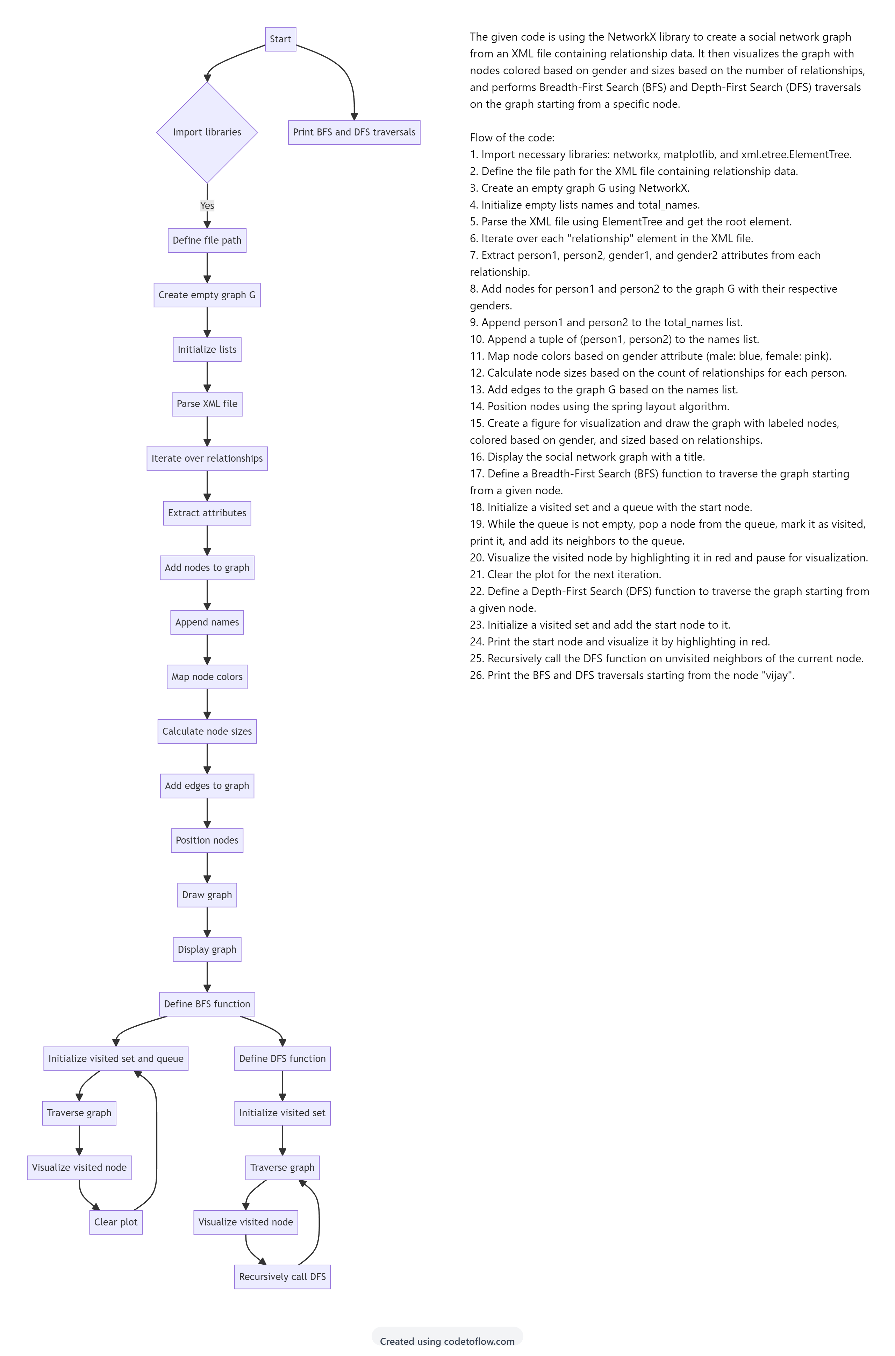

Slide 63
IMPLEMENTATION

Slide 64
import networkx as nx
import matplotlib.pyplot as plt
import xml.etree.ElementTree as ET
file = "D:/PYTHON/PROJECT REV/SOCIAL NETWORKING/realationship.xml"
G = nx.Graph()
names = []
total_names=[]
Tree = ET.parse(file)
Root = Tree.getroot()
for item in Root.iter("relationship"):
person1 = item.attrib["person1"]
person2 = item.attrib["person2"]
gender1 = item.attrib["gender1"]
gender2 = item.attrib["gender2"]
G.add_node(person1, gender=gender1)
G.add_node(person2, gender=gender2)
total_names.append(person1)
total_names.append(person2)
names.append((person1, person2))
color_map = nx.get_node_attributes(G, "gender")
for key in color_map:
if color_map[key] == "male":
color_map[key] = 'blue'
if color_map[key] == "female":
color_map[key] = "pink"
gender_color = [color_map.get(node) for node in G.nodes()]
node_sizes=[(total_names.count(node)*500) for node in G.nodes()]
G.add_edges_from(names)
pos = nx.spring_layout(G) # Position nodes using Fruchterman-Reingold force-directed algorithm
plt.figure(figsize=(10, 6)) # Adjust figure size if needed
nx.draw(G, pos, with_labels=True, node_color=gender_color, node_size=node_sizes)
plt.title('SOCIAL NETWORK')
plt.pause(1)
plt.show()

Slide 65
# Depth-First Search (DFS)
def dfs(graph, start, visited=None):
if visited is None:
visited = set()
visited.add(start)
print(start, end=' ')
# Visualization: Highlight the visited node
nx.draw(graph, pos=pos, with_labels=True, node_color=['red' if n == start else 'skyblue' for n in graph.nodes()],node_size=node_sizes)
plt.title(f'DFS Traversal: Visiting {start}')
plt.pause(1)
plt.clf()
for neighbor in graph.neighbors(start):
if neighbor not in visited:
dfs(graph, neighbor, visited)
# Breadth-First Search (BFS)
def bfs(graph, start):
visited = set()
queue = [start]
while queue:
node = queue.pop(0)
if node not in visited:
visited.add(node)
print(node, end=' ')
neighbors = graph.neighbors(node)
queue.extend(neighbors)
# Visualization: Highlight the visited node
nx.draw(graph, pos=pos, with_labels=True, node_color=['red' if n == node else 'skyblue' for n in graph.nodes()],node_size=node_sizes)
plt.title(f'BFS Traversal: Visiting {node}')
plt.pause(1)
plt.clf()
print("BFS Traversal:")
bfs(G, "vijay") # Start BFS from node vijay
print()
print("\n\nDFS Traversal:")
dfs(G, "vijay") # Start DFS from node vijay

Slide 66
END

